Slide 1
Deadlock Resolution of Multi-robot Systems using Neural Logic Machines
Ruiyang Wang

Slide 2

Deadlock situation for multi-robot systems

Slide 3
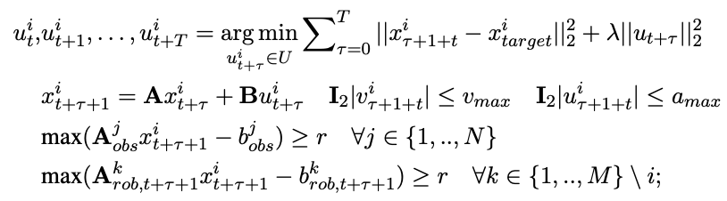
Formal Definition of Deadlocks

Slide 4
Formal Definition of Deadlocks

Slide 5
Formal Definition of Deadlocks
We want to resolve the deadlock and all robots arrive at their targets as soon as possible

Slide 6
Resolution to the deadlock situation

Slide 7
Resolution to the deadlock situation
Move Away

Slide 8
Resolution to the deadlock situation
Move Away

Slide 9
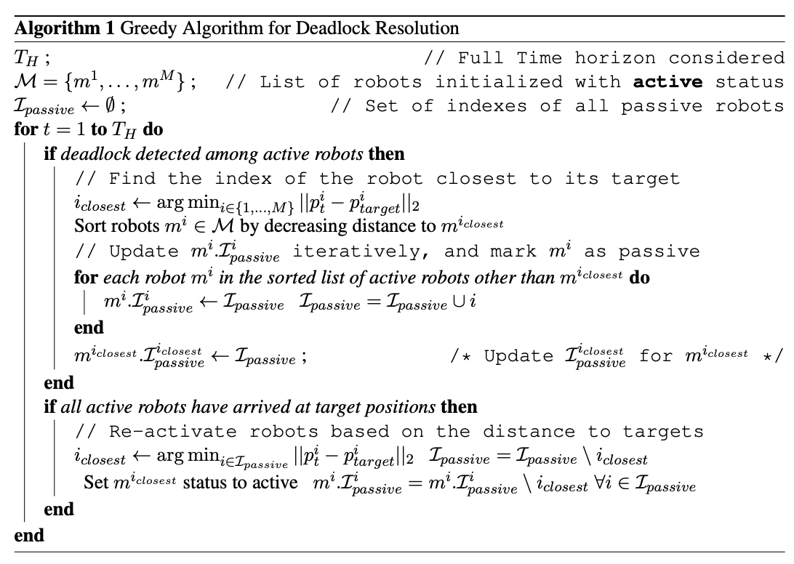
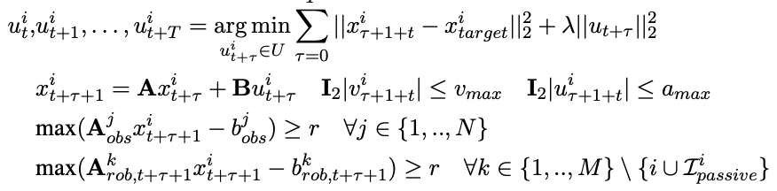
Deadlocks Resolution
We start the simulation with all robots have an active status, whose control is optimized for:

Slide 10
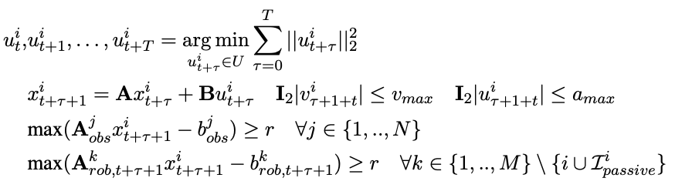
Deadlocks Resolution
When deadlock is detected, we use a greedy algorithm to select some agents to be passive, whose control is optimized for:
Now, the only objective for the passive robots is to avoid other robots

Slide 11
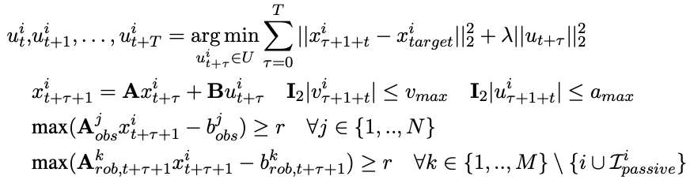
Deadlocks Resolution
We start the simulation with all robots have an active status, whose control is optimized for:
With that, we can remove the constraint for collision avoidance between active and passive robots in active robots’ optimization problem.

Slide 12
Deadlocks Resolution
We keep the robot that is closest to its target be active when detect deadlocks and continue to select robots to be passive until the deadlock is resolved.
For a multi-robot systems with n robots, we at most need to select n-1 robots to be passive and the remaining active robot is guaranteed to arrive at its target when ignoring all other robots.
But this is inefficient, we propose to use Neural Logic Machines to make these selections

Slide 13
Deadlocks Resolution
After all active robots have arrived their targets, we set passive robots to become active based on their distance to their own target one at a time

Slide 14
Resolution to the deadlock situation
Logics on agent m_{i}
…
S₁
Set the agent with the highest S score to be passive
NLM
Predicates
…
S₂
…
…

Slide 15
Resolution to the deadlock situation
Predicates:
True if agent m_{j} blocked
m_{i} to move for any of the
four directions
True if agent m_{i} is able to
move along its front direction
True if agent m_{i} is able to
move along its back direction
True if the distance agent
m_{j} to m_{j}’s target is closer
m_{i} to m_{i} ’s target
True if agent m_{i} is able to
move along its right direction
True if agent m_{i} is able to
move along its left direction
True if m_{j} has a higher
priority than m_{i}
Action:
Set agent m_{i} to passive status

Slide 16
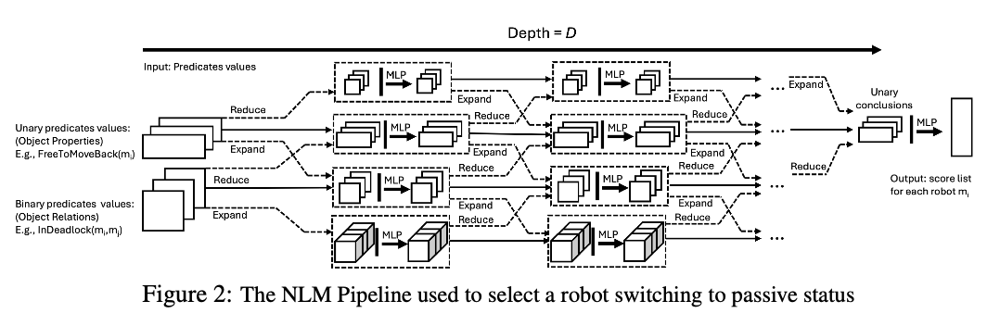

Slide 17
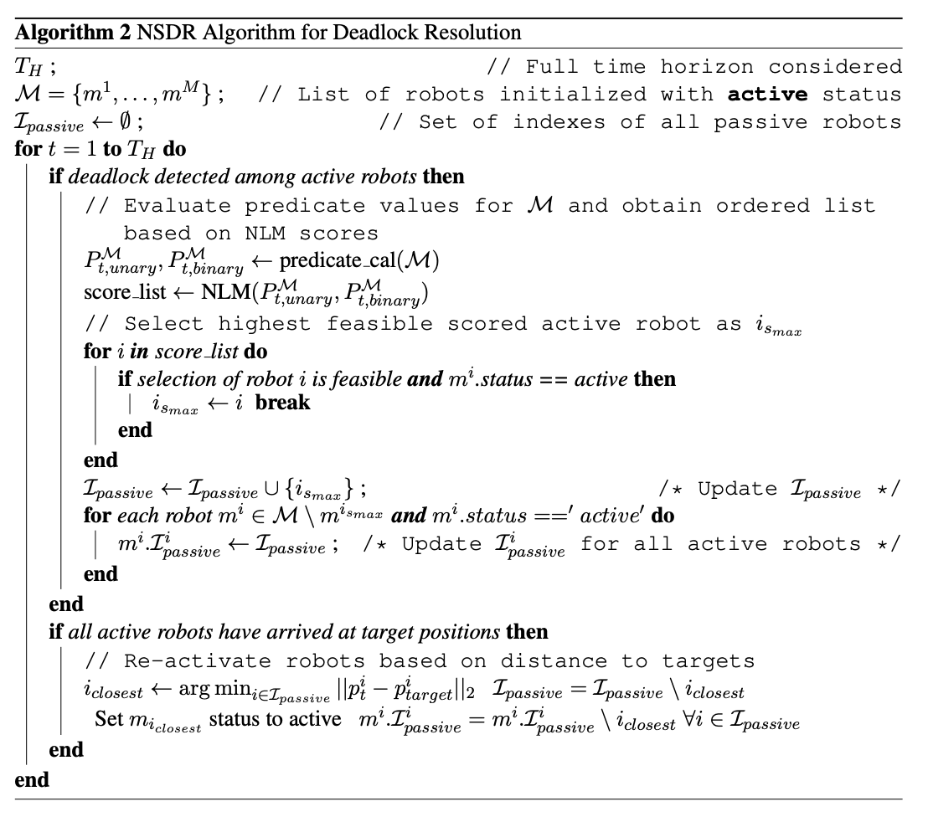
Select passive robots based on the score from NLM.
Check whether the selection is feasible
Update passive robots list for each robot.
After all active robots have arrived at their target position, we reactivate passive robots based on their distance to targets.

Slide 18
Resolution to the deadlock situation
When trained on a small world (involving 2 to 5 agents?), the NLM can learn the logic
and generalize to play the game over much larger worlds (involving 10 agents?)

Slide 19
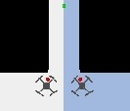
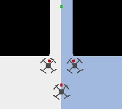
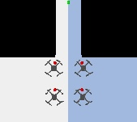
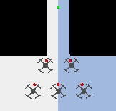
Training Scenarios
Num robots = 2
Num robots = 3
Num robots = 4
Num robots = 5
For each scenario, we generate all possible selections of passive robots and recorded the arrival time of each agent.
We also augmented the data by including all possible orders of assigning agents to deadlock positions
We also augmented the data further by including 5 different random priorities by randomly assign priorities of 1 or 2 each agent.

Slide 20
Training Scenarios
Num robots = 2
Num robots = 3
Num robots = 4
Num robots = 5
We obtained 4299 number of different sets of predicates along with the best passive agent selected that minimized the weighted sum of arrival times of all agents based on a set of predicates
We then divide the whole dataset into 5 folds and performed a supervised 5-fold cross validation training
The resulting model can achieve 99.74% training accuracy and 99.55% validation accuracy

Slide 21
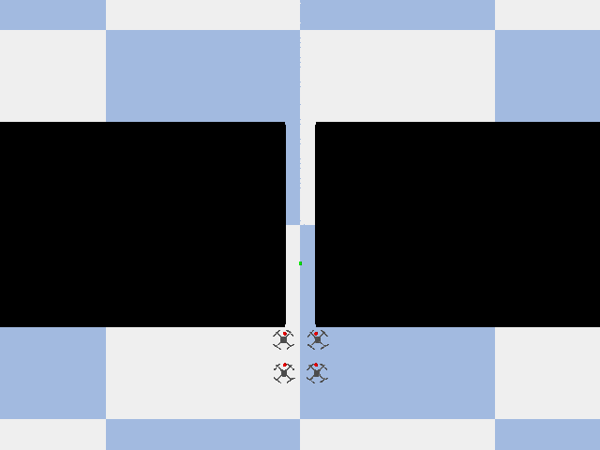
In Sample Test
Greedy Method
NLM Method
Completion Time: 218 steps
Completion Time: 209 steps

Slide 22
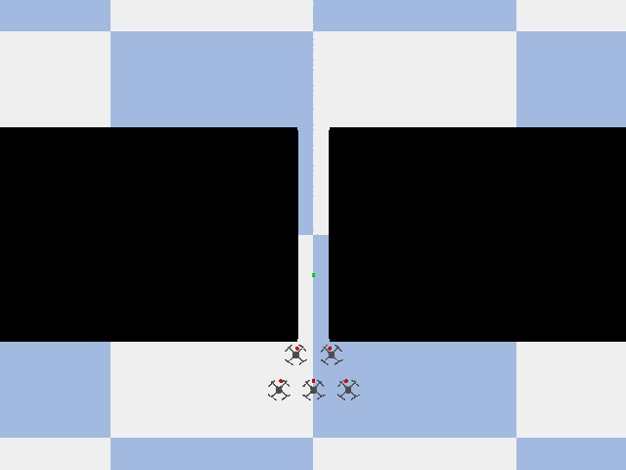
In Sample Test
Greedy Method
NLM Method
Completion Time: 282 steps
Completion Time: 221 steps

Slide 23
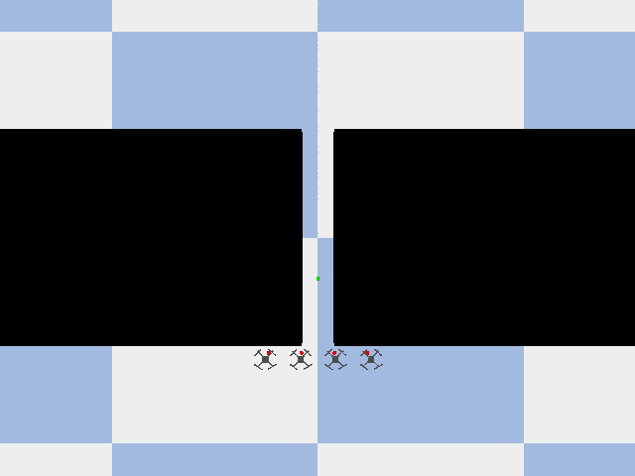
Out Sample Test
Greedy Method
NLM Method
Completion Time: 230 steps
Completion Time: 202 steps

Slide 24
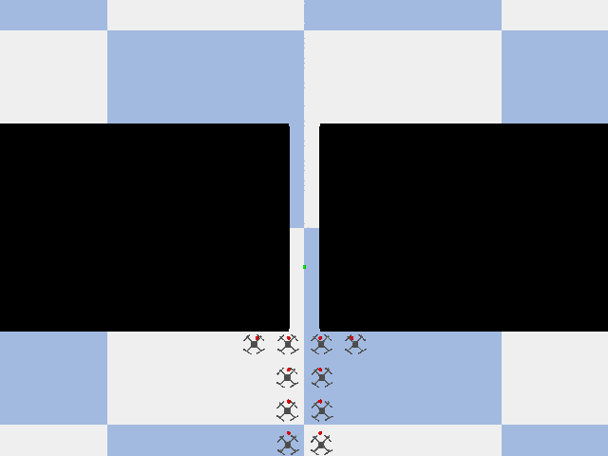
Out Sample Test
Greedy Method
NLM Method
Completion Time: 696 steps
Completion Time: 573 steps

